Slide 1
PERFORMANCE APPRAISAL
Cdr Vijay Pratap Singh
Adjunct Professor E&TC, TCET

Slide 2
DEFENITION
A systematic, periodic and an impartial rating of an employee’s excellence in the matters pertaining to his present job and his potential for a better job

Slide 3
NEED FOR PERFORMANCEEVALUATIONS
Provide a review of past work performance.
Establish lines of communication.
Create an opportunity to discuss professional development goals and objectives.
Document employee performance
Document corrective action necessary to improve work performance

Slide 4
AIMS OF PERFORMANCE APPRAISAL
To review the performance of the employees.
To judge the gap between the actual and the desired performance.
To help the management in exercising organizational control.
To diagnose the training and development needs of the future.
Provide information to assist in the HR decisions like promotions, transfers etc.
To reduce the grievances of the employees.
To strengthen the relationship and communication between management and employees

Slide 5
OBJECTIVES OF PERFORMANCE APPRAISAL
Work related objectives –
To provide a control for work done
To improve efficiency
To help in assigning work and plan future work assignment
To carry out job evaluation

Slide 6
OBJECTIVES OF PERFORMANCE APPRAISAL
Career Development objectives –
To identify strong and weak points and encourage finding remedies for weak points through training
To determine career potential
To plan developmental (promotional or lateral assignments) and
To plan career goals

Slide 7
OBJECTIVES OF PERFORMANCE APPRAISAL
Objectives Of Communication-
To provide adequate feed back on performance
To clearly establish goals, i.e what is expected of the staff members in terms of performance and future work assignments
To provide counselling and job satisfaction through open discussion on performance
To let employees assess where they stand within the organization in terms of their performance

Slide 8
OBJECTIVES OF PERFORMANCE APPRAISAL
Administrative objectives-
To serve as a basis for promotion or demotion
To serve as a basis for allocating incentives
To serve as a basis for determining transfers
To serve as a basis for termination in case of reduction of staff

Slide 9
ELEMENTS OF PERFORMANCE APPRIASAL
Setting performance goals and objectives
Measurement of performance against the goals and objectives
measurement of performance against key competencies
Feedback of results
Amendment to goals and objectives
Determining key competencies

Slide 10
CHARACTERISTICS OF EFFECTIVE PERFORMANCE APPRAISAL
The philosophy, purpose and objectives of the organization are clearly stated so that performance appraisal tools can be designed to reflect these
The purpose of performance appraisal are identified, communicated and understood
Job descriptions are written in such a manner that standards of job performance can be identified for each job
The appraisal tool used is suited to the purposes for which it will be utilized and is accompanied by clear instructions for its use.

Slide 11
CHARACTERISTICS OF EFFECTIVE PERFORMANCE APPRAISAL
Evaluators are trained in the use of the tool.
The performance appraisal procedure is delineated, communicated and understood.
Plans for policing the appraisal procedure and evaluating appraisal tools are developed and implemented.
Performance appraisal has the full support of top management.
Performance appraisal is considered to be fair and productive by all who participate in it.

Slide 12
OBSTACLES TO EFFECTIVE PERFORMANCE APPRAISAL
Lack of support from top management
Resistance on the part of evaluator because-
Performance appraisal demands too much of supervisors efforts in terms of time, paperwork, and periodic observation of subordinates’ performance.
Supervisors do not fully understand the purposes and procedures of performance appraisal.

Slide 13
OBSTACLES TO EFFECTIVE PERFORMANCE APPRAISAL
Supervisors lack skills in appraisal techniques.
Performance appraisal is not perceived as being productive.
Evaluator biases and rating errors.
Lack of clear, objective standards of performance.
Failure to communicate purposes and
Lack of suitable appraisal tool.
Failure to police the appraisal procedure effectively.

Slide 14
STEP BY STEP GUIDE TO PERFORMANCE APPRAISAL
Develop performance standards
Future goals and objectives
Rewarding performance
Performance appraisal interview
Setting goals and objectives
Data collection

Slide 15
A. DEVELOP THE STANDARDS FOR EVALUATION
Performance standards are-
Based on the position, not the individual
Observable, specific indicators of success
Meaningful, reasonable and attainable
Expressed in terms of quality, quantity, timeliness, cost safety or outcomes

Slide 16
B. SETTING OBJECTIVES
Specific
Performance oriented
Realistic
observable

Slide 17
C. DATA COLLECTION
Source of performance information-
Personal observation
Reports, documentation, correspondence etc
Feedback (internal and external)
Periodic discussions with employee

Slide 18
D. PERFORMANCE APPRAISAL INTERVIEW
Review standards, documentation and job description as well as the appraisal from and various ratings
Write the appraisal
Know the person’s record thoroughly
Prepare the employee in advance

Slide 19
GUIDELINES FOR CONDUCTING THE INTERVIEW
Establish a friendly, helpful, purposeful tone at the outset of the discussion. Be at ease.
Ask for the subordinate’s opinion of his or her performance since the last appraisal.
Recognize the staff nurse’s accomplishments and contributions to the hospital.
Be ready to suggest specific developmental activities suitable to each employee’s needs.
Make sure that the session is truly a discussion.

Slide 20
GUIDELINES FOR CONDUCTING THE INTERVIEW
List disagreements: if possible, disagreements should be resolved before the end of the interview.
Make certain that your employees fully understand your appraisal of their performance.
Discuss the future as well as the past. Plan with the employee specific changes in performance or specific developmental activities that will allow fuller use of potential.
End the discussion on a positive, future –improvement- oriented note.
Document the conclusions.

Slide 21
E. FUTURE GOALS AND OBJECTIVES
At the end of the interview, the employer should allow some time to create a development plan.
The employer should record specific goals, targets or benchmarks that the employee will attempt to achieve.
Both employer and employee should agree on the steps to be taken to achieve these targets,
Both should agree on how the employee’s progress towards these objectives will be measured and set a defined timeframe, even if this is simply the next performance appraisal.

Slide 22
F. FOLLOW UP
Follow up means more than simply conducting regular formal performance reviews once a year.
If employers review employees and provide feedback as part of everyday management, both employers and the employee will learn much more about their strengths, weaknesses and how employers would prefer the job to be done.

Slide 23
G. THE PERFORMANCE EVALUATION REPORT
Class specification and / or informal job description.
Job standards, procedures and regulations.
Established goals, objectives and expectations.
Knowledge and abilities to perform the job.
Job relationships required for successful performance, i.e supervisors, co-workers, county employees and the public.

Slide 24
G. THE PERFORMANCE EVALUATION REPORT
Quality of work, including the nature and consequences of errors made during the evaluation period.
Production rate, if applicable.
Commendations awarded relative to employee performance.
Use of job skills and efforts to enhance skills.
Ability to work with others.
Attendance, use of sick leave, punctuality.

Slide 25
Questions to consider when preparing to write the performance report:
Did the employee meet or exceed quantity and quality standards?
Does the employee have the skills to perform the job?
Has the employee increased skill level and established value to the organization?
If corrective action was instituted due to errors and /or complaints that damaged the efficiency of organizational operations, was it effective?

Slide 26
Questions to consider when preparing to write the performance report:
Has the employee demonstrated job related efficiency through special efforts and capabilities?
Does the employee follow organizational rules and standards of the department?
Does the employee utilize supervisory guidance?

Slide 27
Guidelines for the writing of the Employee Performance Report
Establishing objectivity in written performance evaluations by avoiding vague subjective terminology.
Use specific job related terms and clearly define intent of comments.
Avoid the use of personal “traits” such as integrity, loyalty, honesty, initiative, etc. Measure employee performance against the job specifications.

Slide 28
H. REWARDING PERFORMANCE
Rewarding performance means providing incentives to, and recognition of, employees for their performance and acknowledging their contributions to the agency’s mission.

Slide 29
H. REWARDING PERFORMANCE
Outstanding ( Level 5): Eligible for an individual cash award up to 5% of base pay; a Quality Sleep Increase; Time Off Award ; or other appropriate equivalent recognition. Additionally, may be eligible for a salary increase of up to 5% from the Human Resource Fund or as per organization’s policy.
Exceeds Expectations (Level 4): Eligible for an individual cash award up to 3 % of base pay; Time –Off Award, non-momentary award or other appropriate equivalent recognition.

Slide 30
H. REWARDING PERFORMANCE
Competent (Level 3): Eligible for awards such as monetary, non- momentary, Time –off, or other appropriate equivalent recognition, given for reasons: other than sustained performance tied to the rating of record.
Minimally Successful (Level 2): Ineligible for any performance recognition.
Unsatisfactory (Level 1): Ineligible for any performance recognition.

Slide 31
METHODS OF APPRAISING PERFORMANCE
Performance appraisal
Traditional methods
Modern Methods

Slide 32
Traditional methods of performance appraisal

Slide 33
1. Essay appraisal method
This traditional form of appraisal, also known as "Free Form method" involves a description of the performance of an employee by his superior.
The description is an evaluation of the performance of any individual based on the facts and often includes examples and evidences to support the information.
A major drawback of the method is the inseparability of the bias of the evaluator.

Slide 34
2. Straight ranking method
This is one of the oldest and simplest techniques of performance appraisal.
In this method, the appraiser ranks the employees from the best to the poorest on the basis of their overall performance.
It is quite useful for a comparative evaluation.

Slide 35
3. Paired comparison
A better technique of comparison than the straight ranking method, this method compares each employee with all others in the group, one at a time.
After all the comparisons on the basis of the overall comparisons, the employees are given the final rankings.

Slide 36
4. Critical incidents methods
In this method of Performance appraisal the evaluator rates the employee on the basis of critical events and how the employee behaved during those incidents.
It includes both negative and positive points.
The drawback of this method is that the supervisor has to note down the critical incidents and the employee behavior as and when they occur.

Slide 37
5. Field review
In this method, a senior member of the Human Resource department or a training officer discusses and interviews the supervisors to evaluate and rate their respective subordinates.
A major drawback of this method is that it is a very time consuming method.
But this method helps to reduce the superiors’ personal bias.

Slide 38
6. Checklist method
The rater is given a checklist of the descriptions of the behaviour of the employees on job.
The checklist contains a list of statements on the basis of which the rater describes the on the job performance of the employees.

Slide 39
7. Graphic rating scale
In this method, an employee’s quality and quantity of work is assessed in a graphic scale indicating different degrees of a particular trait.
The factors taken into consideration include both the personal characteristics and characteristics related to the on the job performance of the employees.
For example a trait like Job Knowledge may be judged on the range of average, above average, outstanding or unsatisfactory.

Slide 40
8. Forced Distribution
To eliminate the element of bias from the rater’s ratings, the evaluator is asked to distribute the employees in some fixed categories of ratings like on a normal distribution curve.
The rater chooses the appropriate fit for the categories on his own discretion

Slide 41
Modern methods of performance appraisal

Slide 42
1. Assessment centers
An assessment centre typically involves the use of methods like social/informal events, tests and exercises, assignments being given to a group of employees to assess their competencies to take higher responsibilities in the future.
Generally, employees are given an assignment similar to the job they would be expected to perform if promoted.
The trained evaluators observe and evaluate employees as they perform the assigned jobs and are evaluated on job related characteristics.

Slide 43
2. Behaviorally anchored rating scales
Is a relatively new technique which combines the graphic rating scale and critical incidents method.
It consists of predetermined critical areas of job performance or sets of behavioral statements describing important job performance qualities as good or bad.
In this method, an employee’s actual job behavior is judged against the desired behavior by recording and comparing the behavior with BARS.

Slide 44
3. Human resource accounting method
Human resources are valuable assets for every organization. Human resource accounting method tries to find the relative worth of these assets in the terms of money.
In this method the Performance appraisal of the employees is judged in terms of cost and contribution of the employees.

Slide 45
3. Human resource accounting method
The cost of employees include all the expenses incurred on them like their compensation, recruitment and selection costs, induction and training costs etc whereas their contribution includes the total value added (in monetary terms).
The difference between the cost and the contribution will be the performance of the employees.
Ideally, the contribution of the employees should be greater than the cost incurred on them.

Slide 46
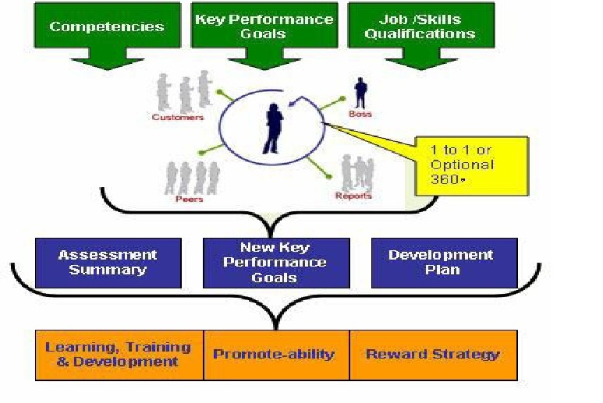
4. 360-Degree-performance-appraisal method

Slide 47
4. 360-Degree-performance-appraisal method
360 degree feedback, also known as 'multi-rater feedback', is the most comprehensive appraisal where the feedback about the employees’ performance comes from all the sources that come in contact with the employee on his job
360 degree appraisal has four integral parts-
Self appraisal
Superior’s appraisal
Subordinate’s appraisal
Peer appraisal.

Slide 48
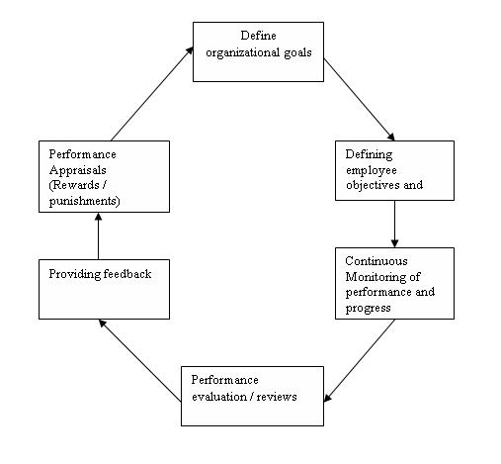
‘Management by Objectives’ (MBO)

Slide 49
‘Management by Objectives’ (MBO)
Clarity of goals – With MBO, came the concept of SMART goals i.e. goals that are: Specific Measurable Achievable Realistic, and Time bound

Slide 50
ERRORS IN WRITING PERFORMANCE EVALUATIONS
The “ halo effect”
The “pitchfork effect” or “ recency effect”.
“Stereotyping”
“Comparing”
“Mirroring”
Managers and supervisors want to avoid being the “ bad guy”.

Slide 51
EFFECTIVE MANAGEMENT OF PERFORMANCE APPRAISAL
The system should be simple, effective, efficient and administratively feasible.
The procedures and uses of the system should be understood and agreed on by line management and the employees being rated.
Factors to be rated should be measurable and agreed on by managers and subordinates.
Raters should understand the purpose and nature of the performance review.

Slide 52
EFFECTIVE MANAGEMENT OF PERFORMANCE APPRAISAL
They should be taught to the use the system, observe, and write notes, including critical incident file, organize notes and write evaluations that include examples of evidence, edit their reports and conduct effective review interviews.
Raters should understand the meanings of the dimensions rated, including the dimensions’ relative weights. Managers are reported to be able to distinguish among only three levels of performance: poor, satisfactory, and outstanding.
Criticism should promote warmth and the building of self esteem for both rate and rater.

Slide 53
EFFECTIVE MANAGEMENT OF PERFORMANCE APPRAISAL
The process should be organized and used to manage employees on a daily basis according to their needs to be coached.
Praise or suggestions for improvement should be done at the time of the event.
Standards of performance should be set and modified at the time of the event.
Performance standards should be valid, reliable and fair.
Managers should be rewarded for good performance evaluation skills.

Slide 54
QUALITIES OF A GOOD APPRAISAL
It is factual
It is fair
It describes the whole period
It describes the whole job
It has no surprises

Slide 55
BENEFITS OF PERFORMANCE APPRAISAL

Slide 56
Benefit for the individual:
Gaining a better understanding of their role
Understanding more clearly how and where they fit in within the wider picture
A better understanding of how performance is assessed and monitored
Getting an insight
Improving understanding of their strengths and weaknesses and developmental needs
Identifying ways in which they can improve performance
Providing an opportunity to discuss and clarify developmental and training needs
Understanding and agreeing their objectives for the next year
An opportunity to discuss career direction and prospects.

Slide 57
Benefit to the line/ manager/supervisor/team leader:
Opportunities to
hear and exchange views and opinions away from the normal pressure of work
to identify any potential difficulties or weaknesses
An improved understanding of the resources available
to plan for and set objectives for the next period
to think about and clarity their own role
to plan for achieving improved performance
to plan for further delegation and coaching
to motivate members of the team

Slide 58
Benefits to the organization
A structured means of identifying and assessing potential
Up-to-date information regarding the expectations and aspirations of employees
Information on which to base decisions about promotions and motivation
An opportunity to review succession planning

Slide 59
Benefits to the organization
Information about training needs which can act as a basis for developing training plans
Updating of employee records ( achievements, new competencies, etc)
Career counseling
Communication of information

Slide 60
PERFORMANCE APPRAISAL IN SAIL
In SAIL there are two types of performance appraisal done on the basis of post the employee.
They are-
Executive performance appraisal system
Non-executive performance appraisal system

Slide 61
PERFORMANCE APPRAISAL IN SAIL
EXECUTIVE PERFORMANCE APPRAISAL SYSTEM
This system is for performance appraisal of executives of the level E-0 to E-4. various steps involved are-
Self appraisal performance review and planning-
Appraise write his/her view over the actual achievement for the KPAs and targets assigned to him for the year
Comments on fulfilment of KPAs and targets are written by the reporting officer, taking account of time frame also
Special jobs other than tasks given and normal routine work are written by the appraise

Slide 62
PERFORMANCE APPRAISAL IN SAIL
PERFORMANCE REVIEW DISCUSSION
Both appraise and reporting officer sit together
Comment over strengths & weakness and areas for development are written which is undersigned by both
Appraise can help the reporting officer by giving examples which shows his strengths and weaknesses. He also tells what training he want to undergo.
PERFORMANCE ASSESSMENT
Rating between 1 to 5 are given to the appraise by the reporting officer & reviewing officer individually on the basis of performance factors and potential factors.
Different weightages are given to each factor
Final scores are calculated by multiplying rating and weightage. By adding these total factor score is calculated
Comments on overall performance and potential are written by both reporting officer and the reviewing officer individually.

Slide 63
PERFORMANCE APPRAISAL IN SAIL
SUGGESTIONS FOR JOB ROTATION AND JOB ENRICHMENT
Both reporting and reviewing officers write their suggestions whether the appraise should be transferred to other department either a good employee so transferred so that he can acquire knowledge of all the departments, or a poor performing employee is transferred so as to improve his performance.
In some exceptional cases head of department gives comments on overall performance and potential of the employee.
FINAL ASSESSMENT
Total factor score by bot reporting and reviewing officers is written and average is calculated.
Final grading between O/A/B/C is given.
On the basis of final grades decision is taken whether to promote the appraise or not.
If not to promote, give reasons.
Meeting with non-promotable employee/appraise.

Slide 64
PERFORMANCE APPRAISAL IN SAIL
NON-EXECUTIVE PERFORMANCE APPRAISAL SYSTEM
Ratings are given by both reporting and reviewing officers on the basis of performance of the appraise depending upon the factors-
Performance on the job
Multi-skill utilization
Conduct & behaviour
Punctuality an availability on the job
Innovations, etc
Weightage are given to various factors
Score out of 100 is calculated by multiplying ratings and weightages
O/A/B/C grades are given according to grades and attendance of the appraise
If grade is C, the appraise is interviewed by the HOD

Slide 65
Thank You!!

